Slide 1


General Overview of Programs and Services
2022

Slide 2

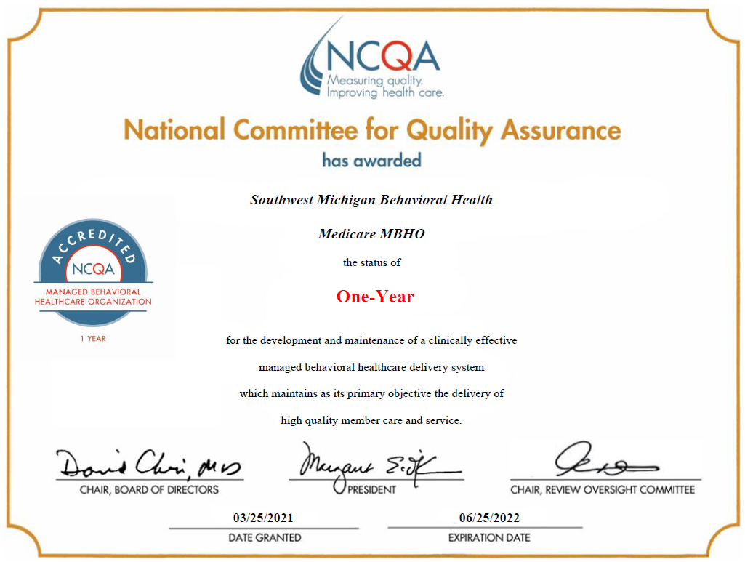
National Committee for Quality Assurance Managed Behavioral Healthcare Organization
SWMBH has maintained MBHO NCQA Accreditation Status and was recently reaccredited in April of 2021.
Only (2) PIHP’s in Michigan have achieved NCQA Accreditation.

Slide 3
The Big Picture
General Overview: Southwest Michigan Behavioral Health (SWMBH) is the Prepaid Inpatient Health Plan (PIHP) for eight Michigan counties, and is in partnership with the Community Mental Health (CMH) agencies of these counties. SWMBH, in partnership with the CMH’s and local providers, provides mental health services to adults with severe and persistent mental illness, children with severe emotional disturbance, individuals with developmental disabilities, and individuals with substance use disorders. As the manager of services, SWMBH will make sure that services are provided to you based on your needs and goals and are within the guidelines set by the state of Michigan. SWMBH Strives to ensure that you and your family members are treated with dignity and respect.
Philosophy: “Quality and Excellence through Partnerships”
Mission: “SWMBH strives to be Michigan’s preeminent benefits manager and integrative healthcare partner, assuring regional health status improvements, quality, value, trust, and CMHSP participant success.”
Vision: “An optimal quality of life in the community for everyone.”

Slide 4
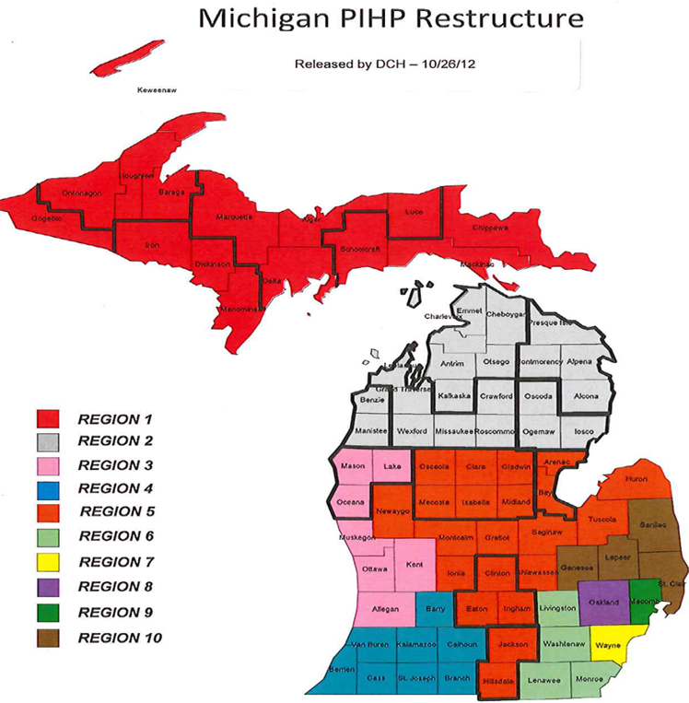
Our Service Area and Partners
Southwest Michigan Behavioral Health is the PIHP and Benefits Manager in Region 4
Service Areas:
Barry County
Berrien County
Branch County
Calhoun County
Cass County
Kalamazoo County
St. Joseph County
Van Buren County
Southwest Michigan Behavioral Health (8) County Service Area

Slide 5
Our People
Dedicated Board and Board Alternates
Dedicated Substance Use Disorder Oversight Policy Board
Highly competent and committed CMH CEOs and management teams
A Senior Leader group second to none
A staff group second to none
A Consumer Advisory Council second to none
Ongoing human capital management and development
  Agency Workplace Culture Objectives and Feedback

Slide 6
Our Values
    Customer Driven
    Person-Centered
    Recovery Oriented
    Evidenced-Based
    Integrated Care System
    Trust
    Integrity
    Transparency
    Inclusive
    Accessibility
    Acceptability
    Impact
    Value
    Culturally Competent & Diverse Workforce
    High Quality Services
    Risk Management

Slide 7
SWMBH Assures
  Access to needed care of the eligible plan members
  Acceptability of purchased services by consumers
  Impact of the care delivered
  Value for taxpayers
  Managed minimal risks for taxpayers
  Access to needed care of the eligible plan members
  Acceptability of purchased services by consumers
  Impact of the care delivered
  Managed minimal risks for taxpayers
  Value for taxpayers

Slide 8
What We Do…..
What we do, is in the details:
Apply for, receive, and administer contracts, grants, gifts, bequests, or assistance funds
Assure compliance to all legal and contractual requirements
Construct, acquire, manage, own, use, operate, maintain, lease or sell real or personal property
Dispose, divide or distribute any property acquired
Manage all mental health, substance use disorders and intellectual disabilities funds provided to the Organization
How we do it and our values:
Improve Population Health
Improve the Plan Member Experience with Care
Reduce the per person cost of care
Promote integration/coordination of physical and behavioral health care
Assure Plan Member access and service satisfaction
Assure value for taxpayer and all purchasers

Slide 9

In an environment of rapid change
Expanded Healthy Michigan
New Autism benefits
Implementation of Behavioral Health Homes and Opioid Health Homes
Duals Demonstration MI Health Link, etc. during
COVID-19 Pandemic

Slide 10
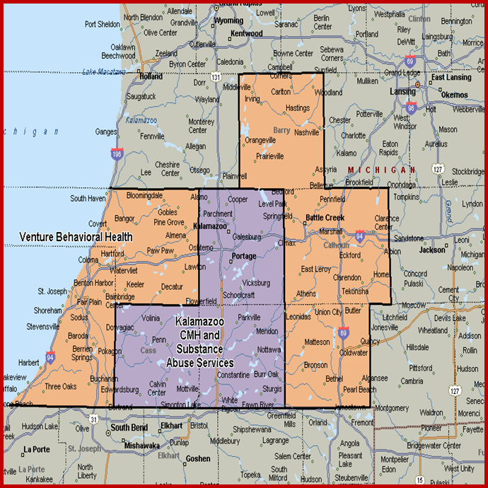
Populations Served
SWMBH has served: roughly 27,760 consumers from October 1, 2020 to September 30, 2021.
Persons served include:
  Adults with SPMI (severe persistent mental illness)
  Adults with Developmental Disabilities
  Adults with Substance Use Disorders
  Children with SED (severe emotional disturbance)
  Children with Developmental Disabilities
Medicaid Eligibles in region
(FY ‘21): 268,868

Slide 11
SWMBH
-How we’re organized…
An independent Board of Directors with one representative from each CMH administers the Governance Policies and directs the Executive Officer
An Executive Officer organizes and oversees the operations.
An Operations Committee composed of the CEOs of the involved eight community mental health organizations provides counsel to the CEO and Board.
Other Committees with representatives from the participant CMH organizations are created to maximize involvement and efficacy;
  Finance, Quality Management, Utilization Management Clinical Practices, Provider Network Management, Information Technology, Customer Services, Compliance.
The Board and CEO are further aided by the Substance Use Disorder Oversight Policy Board, the Consumer Advisory Committee.

Slide 12
SWMBH
-How we do it, our structure…
SWMBH is a Michigan governmental entity known as a Regional Entity, one of 10 in the state
  We’re separate from each of the 8 CMHSPs which established it.
    Source statute: Michigan Mental Health Code 330.1204b.
  SWMBH has its own Governing Board, with a representative appointed by each Participant CMHSP.
  Each CMHSP Board has approved SWMBH Bylaws.
  The SWMBH Board approved the Operating Agreement and signed Conflict of Interest forms.
SWMBH is also the Coordinating Agency for the 8 county region, and..
SWMBH is one of 4 Medicare-Medicaid Dual Eligibility Demonstration regions in the state.

Slide 13


Slide 14
2022-2024 Initiatives
Opioid Health Homes (OHH) in Kalamazoo and Calhoun counties.
  Probable expansion in 2022 in more counties, when and where TBD. Quality withhold metrics bonus accrues to OHHPs not SWMBH but are still important.
Certified Community Behavioral Health Clinics (CCBHC) in Kalamazoo and St. Joseph counties with CMHSPs. Special attention to clinical, patient flow, data reporting and finance.
  Probable expansion in 2022 in more counties, when and where TBD. Quality withhold metrics bonus accrues to CCBHCs not SWMBH but are still important.
MI Health Link (MHL) (federal-state dual eligibles Medicare/Medicaid Demonstration) across the Region.
Reinvigorate Population Health Plan and efforts, defer until July 1, 2022.
Reinvigorate Integrated Care Plan. Defer until July 1, 2022. Support Integrated Care Team and enhance contractual obligations with MHPs, ICOs, CMHs, PCPs and assure full $2.6 million PBIP earnings.
  Focus on MHL and Medicaid high physical health needs clients, especially the FFS/no MHP.
Reinvigorate Healthcare Information Exchange efforts inside region and across stakeholders.
Reinvigorate Healthcare Data Analytics efforts
  CC 360, Tableaus, Relias Population Health, Milliman Drive Tools enhancement and expanded uses.

Slide 15
2022-2024 Initiatives
Assure maximization of rebasing/rate-setting and future capitation funds.
Assure Board Ends Metrics achievement.
Assure Diversity, Equity and Inclusion improvements.
Fix all things HSAG: PMV, PIPs, Compliance.
Address performance under revised new Michigan Mission-Based Performance Indicator (MMBPIS) System Metrics.
Assure tele-health expansion, service use and coding across provider network.
Install and analyze American Society of Addiction Medicine (ASAM) Continuum of Care Tool and results.
Install eConsent Pilot.
Assure Provider stability and enhance professional and paraprofessional staff
Enhance Self-Determination and related topics through Building Better Lives Project. A 12–18-month horizon is expected and accepted.

Slide 16
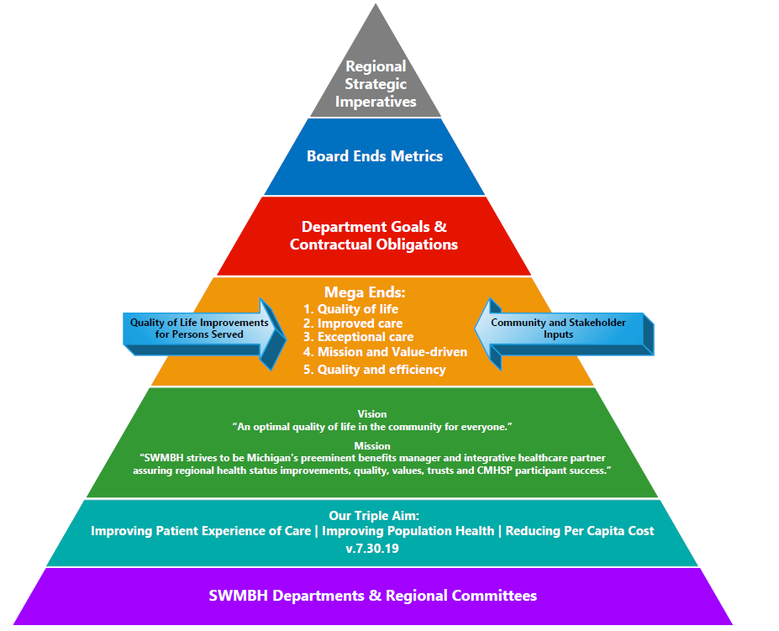
2022 Regional Strategic Alignment Framework

Slide 17
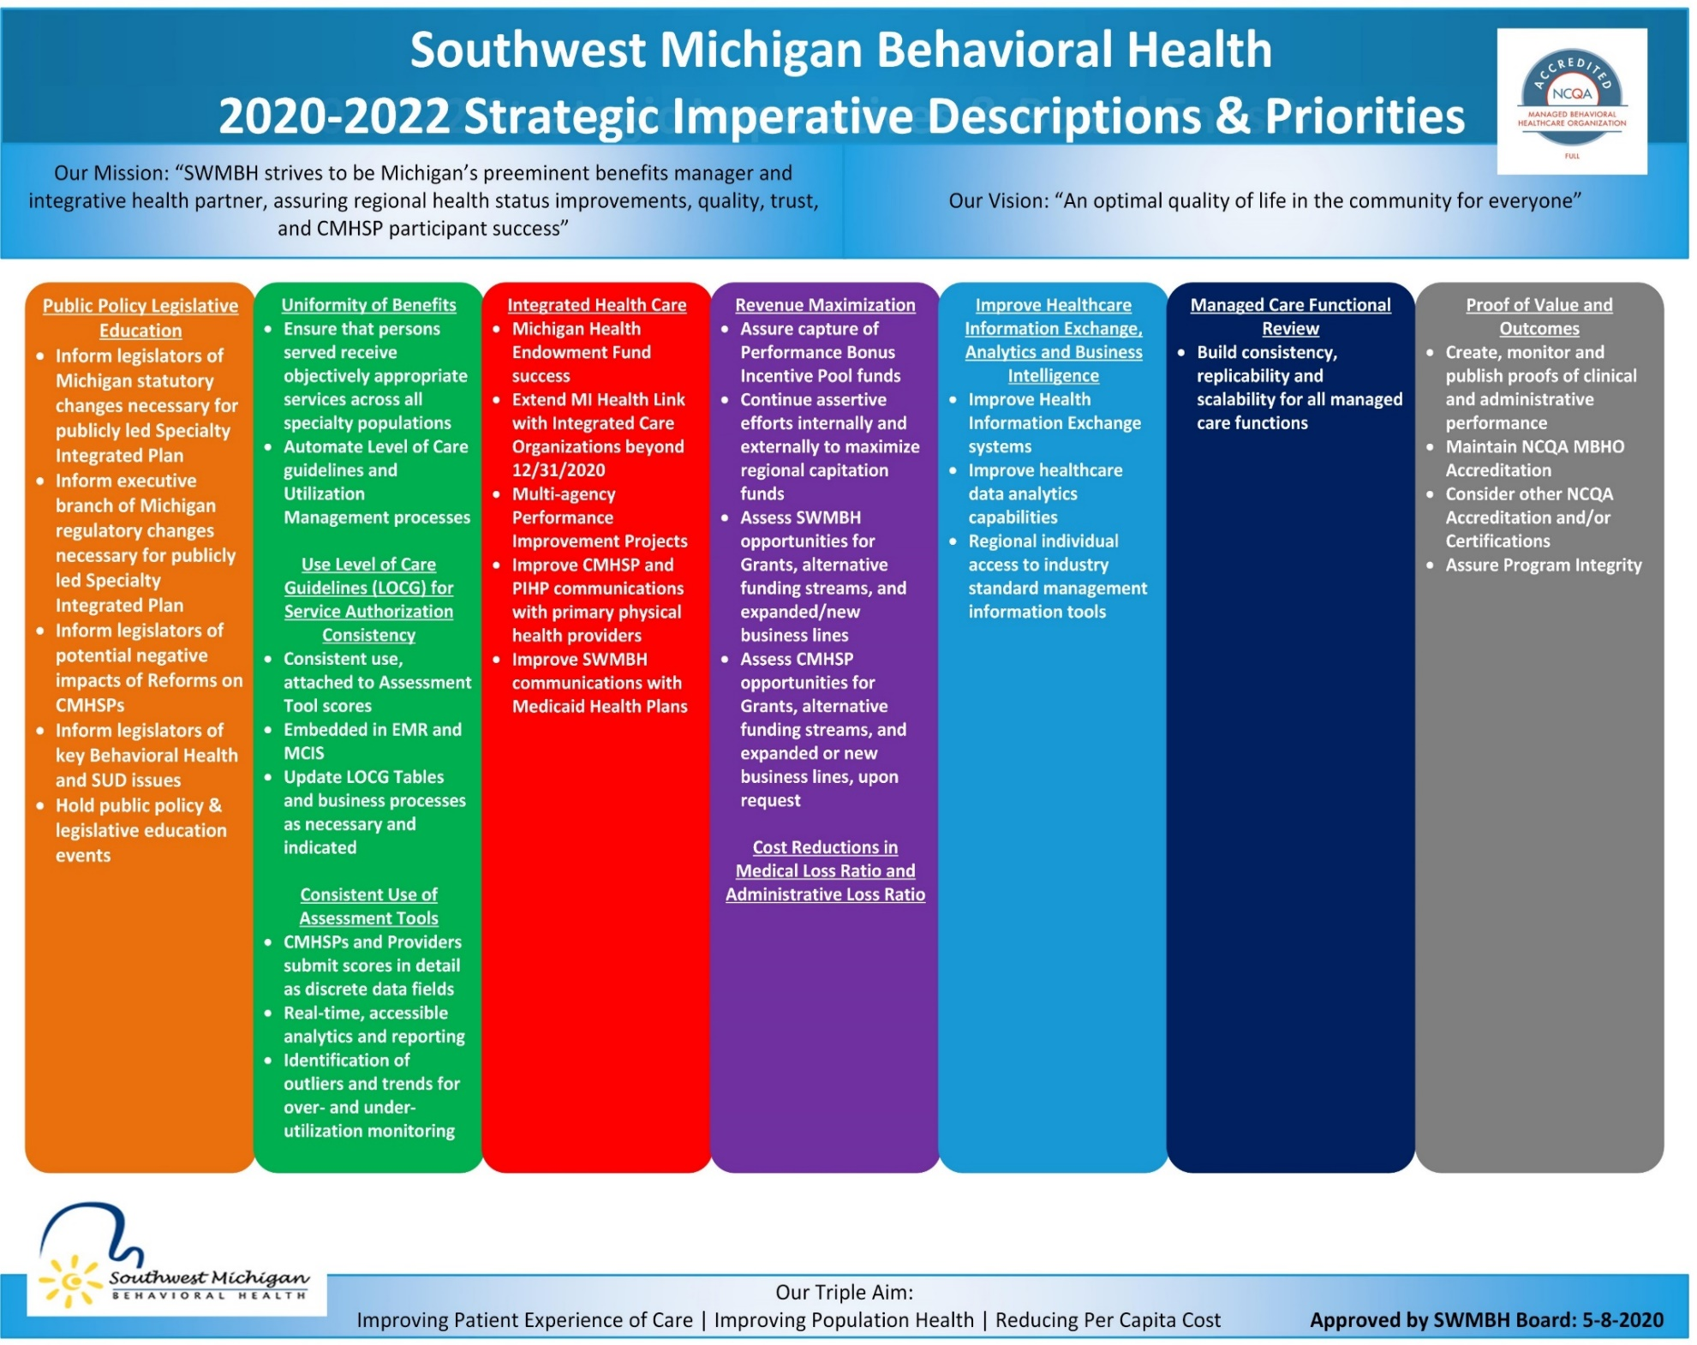

Slide 18
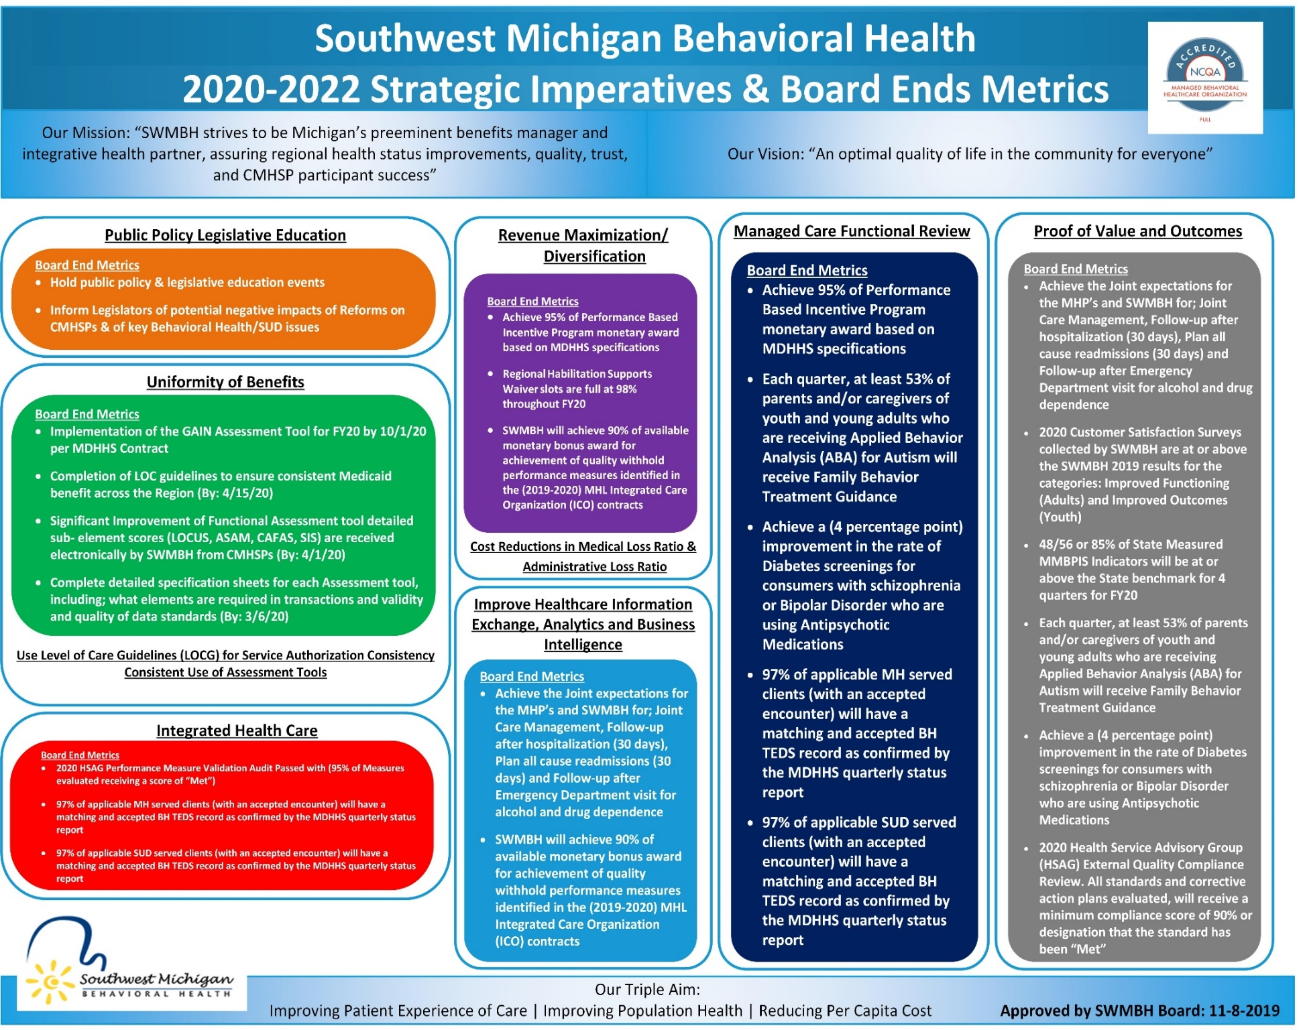

Slide 19
2021 Successes and
Accomplishments
CLICK HERE FOR THE FULL LIST OF 2021 SWMBH SUCCESSES AND ACCOMPISHMENTS

Slide 20
2021 Successes and Accomplishments
SWMBH acted as a critical source of guidance for our External Stakeholder partners, supporting telehealth services, distributing personal protective equipment, and implementing new technology to provide consistent and improved communications.
SWMBH Successfully achieved National Committee for Quality Assurance (NCQA), Managed Behavioral Health Organization (MBHO) Reaccreditation for the SWMBH Medicare Business Line, which is good until June 25, 2022. Only (2) Prepaid Inpatient Health Plans (PIHP’s) in Michigan currently hold NCQA accreditation.
There was a 43.9 % reduction in Emergency Room (ER) claims and 73.3% reduction in inpatient episodes, for the six months prior to Integrated Co-occurring Treatment (ICT) involvement versus six months post ICT involvement. Overall, there were less ER claims this year than in years prior (65.1% decrease). It is speculated that this could have been affected by COVID and that people were less likely to use the ER until they were severely ill.
SWMBH Substance Use Disorder Team Trained community members in overdose education and naloxone distribution (2,694 kits distributed).This resulted in over 120 overdose reversals that were reported by community members and law enforcement agencies.
SWMBH achieved 100% compliance on the 2020-2021 Performance Bonus Incentive Programs State Sponsored Metrics. This translates into $2,894,028.48 in Regional Bonus earnings.
SWMBH achieved a compliance rate of 92.1% on the 2020-2021 Michigan Mission Based Performance Indicator System Metrics (MMBPIS). The States and SWMBH target were to achieve 85%. 92.1% makes SWMBH the 2nd highest achieving PIHP in Michigan.

Slide 21
2021 Successes and Accomplishments (Continued)
SWMBH has filled 99.84% of (710) available Habilitation Supports Waiver slots provided by the State from October 1, 2020 through September 30, 2021. SWMBH has led all PIHP’s in percentage available/filled Waiver slots over the past 4 years.
SWMBH has provided nearly 5 million in Provider Network Stability Payments.
SWMBH Served as a liaison for Certified Community Behavioral Health Clinic (CCBHC) for the region in communicating requirements from the State to the participating CCBHC sites.
Provided clinical training at 9 events, training 334 attendees on the following topics: Ethical Considerations for Coaches, Medical Necessity Guidelines for Applied Behavior Analysis, LGBTQ+ Diversity, Clinical Supervision, and Charting the Life Course tools for Person-Centered Planning.
Clinical and Substance Use Disorder Quality teams completed reviews for 42 different service providers across 5 different service lines (General CMHSP Clinical and SUD Quality, Psychiatric Inpatient, Applied Behavior Analysis, and Crisis Residential).
Reviewed 345 individual case files and provided feedback on ways to meet higher clinical standards.
Completed 5,986 American Society of Addiction Medicine (ASAM) assessments for clients diagnosed with a Substance Use Disorder (SUD).
Handled 16,752 incoming Substance Use Disorder (SUD) calls with an average phone queue time of 7 seconds. This far exceeds the National Standard of 30 seconds.

Slide 22
Evaluation of Performance 2021 Performance Metrics
Successful management of the HSAG Compliance Audit, Performance Improvement Projects (PIPs), Michigan Department of Health and Human Services and Performance Measure Validation Audits.
Successful management and completion of MI Health Link audits and reviews.
Successful submission of data elements: Jail Diversion, Behavioral Treatment Review Committee (BTRC) Minutes, MMBPIS, and Critical Incidents to MDHHS.
Successful completion of all established targets identified in: 2020 Board Ends Metrics.
Successful completion of all QAPI and UM Department goals.
Successful completion of MI Health Link contract reporting requirements with Integrated Care Organizations (ICOs).
Successful in capturing MHL Quality Withhold Bonus Awards for good performance.
Successful completion of all established Quality Management Committee goals.
Continued improvement in Consumer Satisfaction Survey scores.
Successful completion of identified budget savings initiatives.
Successful completion of Legislative Events and agendas.
Ranked 1st amongst all Michigan PIHP's in the 2021 Health Service Advisory Group (HSAG) External Quality Compliance Results.

Slide 23
Key Performance Metric Results

Slide 24
2021 Board Ends Metrics Achieved
Board Ends Metric | Metric Result | Board Approved Date
2021 PBIP Narrative Report Achieve 95% of Performance Based Incentive Program monetary award based on MDHHS specifications. | Metric Achieved Notice provided by MDHHS on 1/29/2021 SWMBH submitted required report on 11/13/2020 100% of metrics achieved and 100% of bonus earned ($2,894,028.48) | Board Presentation and Approval on: 3/9/21
2020 PBIP Metrics Reports Achieve the following Joint expectations for the MHP’s and SWMBH. There are 100 points possible for this bonus metric in CY20 | Metric Achieved Notice provided by MDHHS on 1/29/2021 SWMBH submitted required report on 11/13/2020 100% of metrics achieved and 100% of bonus earned ($2,894,028.48) | Board Presentation and Approval on: 3/9/21
2020 Customer Satisfaction Surveys collected by SWMBH are at or above the SWMBH 2019 results for the following categories: Mental Health Statistic Improvement Project Survey (MHSIP) tool. (Improved Functioning) Youth Satisfaction Survey (YSS) tools. (Improved Outcomes) | Metric Achieved The Annual Satisfaction Survey Project was completed on 2/5/2021. The MHSIP (adult) ‘Improved Functioning’ category observed an improvement of +1.72% (86.82%) over the previous year’s result (85.1%). The YSS (youth) ‘Improved Outcomes’ category observed an improvement of +1.74% (83.04%) over the previous year’s result (81.30%). | Board Presentation and Approval on: 3/9/21

Slide 25
2021 Board Ends Metrics Achieved
2020 Health Service Advisory Group (HSAG) External Quality Compliance Review (90% of Sections evaluated receiving a score of “Met”). | Metric Achieved On December 18, 2020 SWMBH was notified by HSAG that is received a score of 99% on the 2020 audit cycle. This score makes SWMBH the highest scoring PIHP for the 2nd consecutive year. | Board Presentation and Approval on: 3/9/21
Each quarter, at least 53% of parents/or caregivers of youth and young adults who are receiving applied behavior analysis (ABA) for Autism will receive Family Behavior Treatment Guidance. This service supports families in implementing procedures to teach new skills and reduce challenging behaviors. | Metric Achieved Q1: 65.2% Q2: 62.7% Q3: 68.2% Q4: 58.8% 895/1405 = 63.72% average | Board Presentation and Approval on: 3/9/21
Achieve a 4-percentage point improvement in the rate of Diabetes screenings for consumers with schizophrenia or Bipolar Disorder who are using Antipsychotic Medications. | Metric Achieved Target: 76% Current Status: 80% | Board Presentation and Approval on: 6/11/21
SWMBH will achieve 90% of available monetary bonus award for achievement of quality withhold performance measures identified in the (2020-2021) MHL Integrated Care Organization (ICO) contracts. | Metric Achieved Meridian = 100% Aetna = 89% Total Percentage Achieved: 94.5% | Board Presentation and Approval on: 4/9/21

Slide 26
2021 Board Ends Metrics Achieved
Board Ends Metric | Metric Result | Board Approved Date
SWMBH will achieve Recertification of National Committee for Quality Assurance (NCQA) – Managed Behavioral Healthcare Organization Medicare Service Line. | Metric Achieved SWMBH was awarded a 1-year reaccreditation by NCQA on March 25, 2021. SWMBH’s Current Accreditation is through June 25, 2022 | Board Presentation and Approval on: 4/9/21
Regional Habilitation Supports (HSW) Waiver slots are full at 98% throughout the year. (10/1/20 – 9/30/21) | Metric Achieved 99.9% of HSW slots have been filed in FY 21, per the MDHHS status report. *SWMBH has been the best performing PIHP in the State for 4 consecutive years. | Board Presentation and Approval on:10/8/2021
48/56 or 85% of State Measured MMBPIS Indicators will be at or above the State benchmark for 4 quarters for FY20 | Metric Achieved Current Status: Q1:6/7 Q2: 7/7 Q3: 7/7 Q4: 7/7 Total Percentage Achieved 35/38 = 92.1% | Board Presentation and Approval on: 4/9/21

Slide 27
Oversight and Monitoring

Slide 28
SWMBH Audit & Monitoring
Program Integrity & Compliance
Medicaid Services Verification Audit
  Quarterly review of services paid for by Medicaid, provided by CMHSPs, subcontractors, SUD providers, top 3 external providers, and top 3 hospitals
Medicare Claims Audit (Duals)
  Monthly review of a minimum of 100 MHL claims
Inpatient Audit
  Annual review of 100 inpatient psychiatric stays paid for by Medicaid
  Includes a code audit of 50 physician codes
HCBS provided in the consumer’s home
  Annual review based on past and continued OIG focus
FY20 implementation
  Block Grant Fee-For-Service claims review
  Oversight of Block Grant Financial Status Reports and SA Data Templates for Net Cost Contracts
Annual Audit & Monitoring Plan and Calendar are vetted through the Regional Compliance Coordinating Committee

Slide 29
SWMBH Audit & Monitoring
Provider Network
Administrative Site Reviews
  Region-wide review of all CMH subcontractors and SUD providers
  Coordinated between SWMBH and CMHSPs
SUD Clinical Quality Review
  Annual review of 5% or minimum 8 records for each SUD provider
CMHSP Clinical Quality Review
  Annual review of minimum of 30 consumer records
  Focuses on entire scope of care
  Samples stratified to pre-determined focus areas (ex. Autism)
Delegated Functions Reviews
  Annual review of Medicaid functions delegated to CMHSPs
  Combination desk audit and on-site review
  Required by PIHP contract with DHHS, SWMBH-CMHSP Delegation Agreements, and Federal Medicaid Managed Care Rules – 42 CFR 438
  Assesses the CMHSPs’ business practices around Delegated Managed Care Functions in the areas of:
    Utilization Management, Customer Services, Grievance and Appeals, Quality Management/Information Technology, Claims Management, and Provider Network.
  Failure to meet PIHP, DHHS, and/or federal requirements could eventually result in revocation of a delegated function.

Slide 30
SWMBH Audit & Monitoring
SUD & Prevention
Prevention Reviews
  Annual review of each Prevention contractor to monitor if contractual outcomes are met
  Monitors prevention activities entered in to State database
P.A. 2 Work Plans and Block Grant Net-Cost Contracts
  Contractually prescribed goals and outcomes
  P.A. 2 providers report outcomes measures twice per year

Slide 31

2021 Regional Survey Overview
The 2021 RSA-r Person in Recovery Survey concluded in early December. This survey looks at the recovery process and services/programs available, for consumers in recovery for drug or alcohol dependence. The following slides represent overall preliminary results. The full report can be accessed by clicking on the following link:
2021 Person in Recovery Survey (RSA-r) Analysis Report

Slide 32
2020 Regional Survey Overview
Annual RSA-r Person in Recovery SUD Survey
Overall Mean Score Comparison
2020: 4.20
(+0.37 increase over 2019)
482 respondents from 18 providers
2021: 4.07
(-0.13 under 2020 results)
475 respondents from 15 providers

Slide 33
Environmental Scan

Slide 34
Medicaid Covered and Served by County (FY 2021)
County Name | # Consumers Covered | # Consumers Served | # of Encounters
Kalamazoo | 71,586 | 7,351 | 674,500
Berrien | 50,973 | 4,295 | 306,300
Calhoun | 51,823 | 7,462 | 223,400
Van Buren | 27,318 | 2,529 | 102,500
St. Joseph | 21,618 | 1,914 | 90,400
Cass | 15,648 | 983 | 60,300
Branch | 15,242 | 1,985 | 46,700
Barry | 14,660 | 1,241 | 29,100
Total: | 268,868 | 27,760 | 1,504,200
Data snapshot taken on 1/3/2022
Data includes Medicaid and Healthy Michigan Business Lines
Source: SWMBH data Warehouse

Slide 35
Population Health and Integrated Care

Slide 36
What is Population Health?
Population Health
Population health is defined as the health outcomes of a group of individuals, including the distribution of such outcomes within the group. It represents a change from individual-level focus of most mainstream medicine, and seeks to complement traditional efforts of public health agencies by addressing a broader range of factors shown to impact the health of different populations.
From a population health perspective, health has been defined not simply as a state free from disease but as "the capacity of people to adapt to, respond to, or control life's challenges and changes." The World Health Organization (WHO) defined health in its broader sense in 1946 as "a state of complete physical, mental, and social well-being and not merely the absence of disease or infirmity.”

Slide 37
population health management – comprehensive approach
The graphic below identifies the spectrum of population, from the healthy to catastrophic with recommended initiatives for each sub-population with particular emphasis on the 15% of members driving 85% of costs.
( 37)

Slide 38
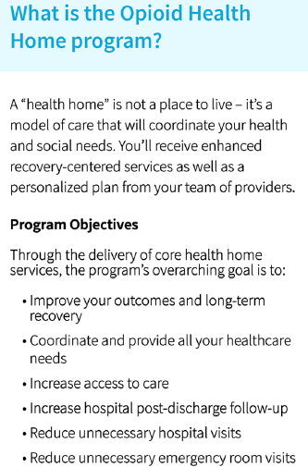
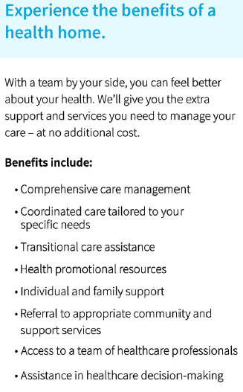
Opioid Health Home Program

Slide 39
