Slide 1

General Overview of Programs and Services
2023

Slide 2

The Big Picture
General Overview: Southwest Michigan Behavioral Health (SWMBH) is the Prepaid Inpatient Health Plan (PIHP) for eight Michigan counties, and is in partnership with the Community Mental Health (CMH) agencies of these counties. SWMBH, in partnership with the CMH’s and local providers, provides mental health services to adults with severe and persistent mental illness, children with severe emotional disturbance, individuals with developmental disabilities, and individuals with substance use disorders. As the manager of services, SWMBH will make sure that services are provided to you based on your needs and goals and are within the guidelines set by the state of Michigan. SWMBH Strives to ensure that you and your family members are treated with dignity and respect.
Philosophy: “Quality and Excellence through Partnerships”
Mission: “SWMBH strives to be Michigan’s preeminent benefits manager and integrative healthcare partner, assuring regional health status improvements, quality, value, trust, and CMHSP participant success.”
Vision: “An optimal quality of life in the community for everyone.”

Slide 3
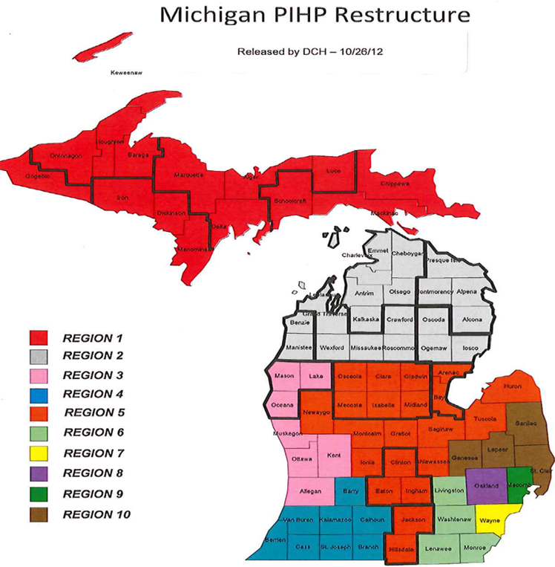
Our Service Area and Partners
Southwest Michigan Behavioral Health is the PIHP and Benefits Manager in Region 4
Service Areas:
Barry County
Berrien County
Branch County
Calhoun County
Cass County
Kalamazoo County
St. Joseph County
Van Buren County
Southwest Michigan Behavioral Health (8) County Service Area

Slide 4
Our People
Dedicated Board and Board Alternates
Dedicated Substance Use Disorder Oversight Policy Board
Highly competent and committed CMH CEOs and management teams
A Senior Leader group second to none
A staff group second to none
A Consumer Advisory Council second to none
Ongoing human capital management and development
  Agency Workplace Culture Objectives and Feedback

Slide 5
Our Values
    Customer Driven
    Person-Centered
    Recovery Oriented
    Evidenced-Based
    Integrated Care System
    Trust
    Integrity
    Transparency
    Inclusive
    Accessibility
    Acceptability
    Impact
    Value
    Culturally Competent & Diverse Workforce
    High Quality Services
    Risk Management

Slide 6
SWMBH Assures
  Access to needed care of the eligible plan members
  Acceptability of purchased services by consumers
  Impact of the care delivered
  Value for taxpayers
  Managed minimal risks for taxpayers
  Access to needed care of the eligible plan members
  Acceptability of purchased services by consumers
  Impact of the care delivered
  Managed minimal risks for taxpayers
  Value for taxpayers

Slide 7
What We Do…..
What we do, is in the details:
Apply for, receive, and administer contracts, grants, gifts, bequests, or assistance funds
Assure compliance to all legal and contractual requirements
Construct, acquire, manage, own, use, operate, maintain, lease or sell real or personal property
Dispose, divide or distribute any property acquired
Manage all mental health, substance use disorders and intellectual disabilities funds provided to the Organization
How we do it and our values:
Improve Population Health
Improve the Plan Member Experience with Care
Reduce the per person cost of care
Promote integration/coordination of physical and behavioral health care
Assure Plan Member access and service satisfaction
Assure value for taxpayer and all purchasers

Slide 8
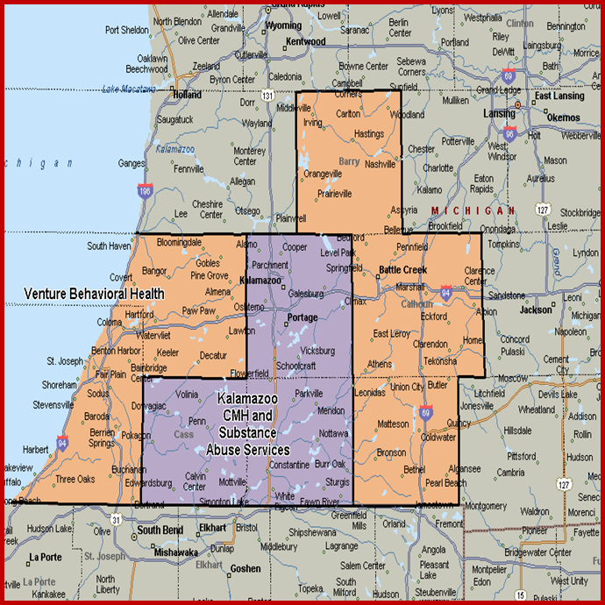
Populations Served
SWMBH has served: roughly 29,360 consumers from October 1, 2021 to September 30, 2022.
Persons served include:
  Adults with SPMI (severe persistent mental illness)
  Adults with Developmental Disabilities
  Adults with Substance Use Disorders
  Children with SED (severe emotional disturbance)
  Children with Developmental Disabilities
Medicaid Eligibles in region
(FY ‘22): 296,488

Slide 9
SWMBH
-How we’re organized…
An independent Board of Directors with one representative from each CMH administers the Governance Policies and directs the Executive Officer
An Executive Officer organizes and oversees the operations.
An Operations Committee composed of the CEOs of the involved eight community mental health organizations provides counsel to the CEO and Board.
Other Committees with representatives from the participant CMH organizations are created to maximize involvement and efficacy;
  Finance, Quality Management, Utilization Management Clinical Practices, Provider Network Management, Information Technology, Customer Services, Compliance.
The Board and CEO are further aided by the Substance Use Disorder Oversight Policy Board, the Consumer Advisory Committee.

Slide 10
SWMBH
-How we do it, our structure…
SWMBH is a Michigan governmental entity known as a Regional Entity, one of 10 in the state
  We’re separate from each of the 8 CMHSPs which established it.
    Source statute: Michigan Mental Health Code 330.1204b.
  SWMBH has its own Governing Board, with a representative appointed by each Participant CMHSP.
  Each CMHSP Board has approved SWMBH Bylaws.
  The SWMBH Board approved the Operating Agreement and signed Conflict of Interest forms.
SWMBH is also the Coordinating Agency for the 8 county region, and..
SWMBH is one of 4 Medicare-Medicaid Dual Eligibility Demonstration regions in the state.

Slide 11


Slide 13
2023 Regional Value Framework
Our Mission | “SWMBH strives to be Michigan’s preeminent benefits manager and integrative healthcare partner, assuring regional health status improvements, quality, value, trust, and CMHSP participant success”.
 |  |  |  |  | 
Mega Ends | Quality of Life | Improved Health | Exceptional Care | Mission and Value-Driven | Quality and Efficiency
 | Persons with Intellectual Developmental Disabilities, Serious Mental Illness, Autism Spectrum Disorder, Serious Emotional Disturbances and Substance Use Disorders in the SWMBH region see improvements in their quality of life and maximize self- sufficiency, recovery and family preservation. | Individual mental health, physical health and functionality are measured and improved. | Persons and families served are highly satisfied with the care they receive. | CMHSPs and SWMBH fulfill their agencies’ missions and support the values of the public mental health system. | The SWMBH region is a learning region where quality and cost are measured, improved and reported.
 |  |  |  |  | 
Quadruple Aim | Improving Patient Experience of Care | Improving Population Health | Reducing Per Capita Cost | Improved Outcomes
 | 
Our Vision | "An optimal quality of life in the community for everyone”.

Slide 14
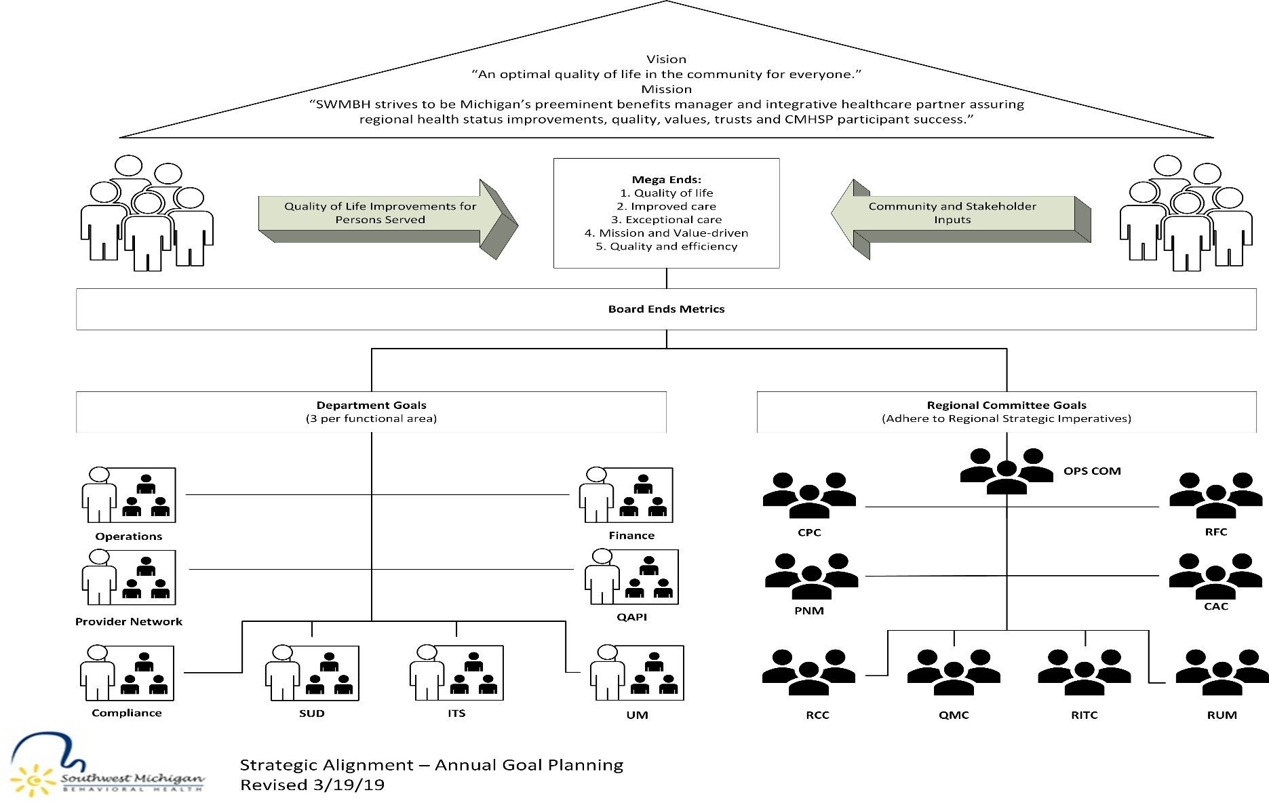
2023 Regional Committee Strategic Alignment

Slide 15
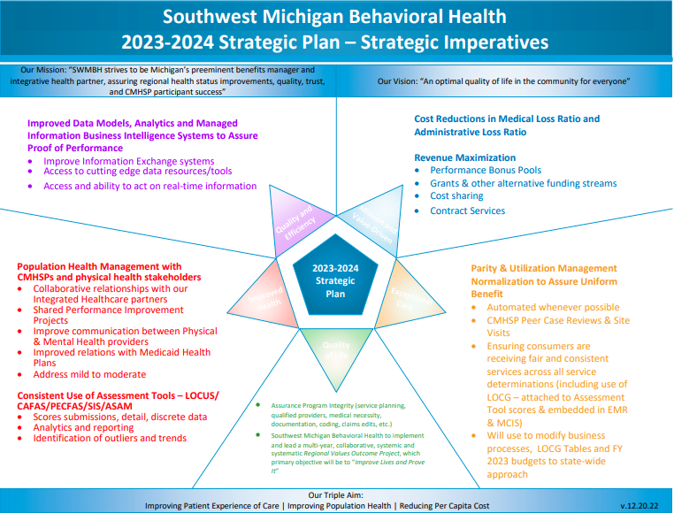
2023 Strategic Imperatives

Slide 16
2022 Successes and
Accomplishments
Please click the below link to view the full report
The Latest News from Southwest Michigan Behavioral Health | Southwest Michigan Behavioral Health (swmbh.org)

Slide 17
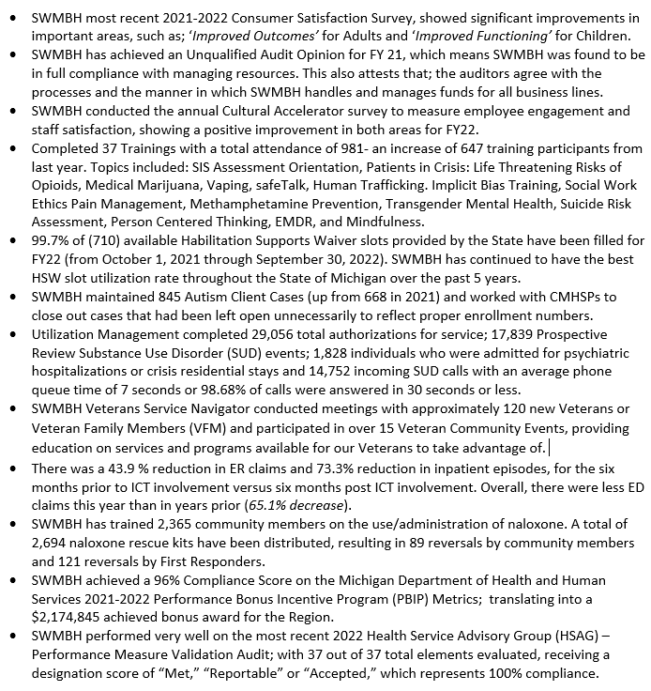
SWMBH most recent 2021-2022 Consumer Satisfaction Survey, showed significant improvements in important areas, such as; ‘Improved Outcomes’ for Adults and ‘Improved Functioning’ for Children.
SWMBH has achieved an Unqualified Audit Opinion for FY 21, which means SWMBH was found to be in full compliance with managing resources. This also attests that; the auditors agree with the processes and the manner in which SWMBH handles and manages funds for all business lines.
SWMBH conducted the annual Cultural Accelerator survey to measure employee engagement and staff satisfaction, showing a positive improvement in both areas for FY22.
Completed 37 Trainings with a total attendance of 981- an increase of 647 training participants from last year. Topics included: SIS Assessment Orientation, Patients in Crisis: Life Threatening Risks of Opioids, Medical Marijuana, Vaping, safeTalk, Human Trafficking. Implicit Bias Training, Social Work Ethics Pain Management, Methamphetamine Prevention, Transgender Mental Health, Suicide Risk Assessment, Person Centered Thinking, EMDR, and Mindfulness.
99.7% of (710) available Habilitation Supports Waiver slots provided by the State have been filled for FY22 (from October 1, 2021 through September 30, 2022). SWMBH has continued to have the best HSW slot utilization rate throughout the State of Michigan over the past 5 years.
SWMBH maintained 845 Autism Client Cases (up from 668 in 2021) and worked with CMHSPs to close out cases that had been left open unnecessarily to reflect proper enrollment numbers.
Utilization Management completed 29,056 total authorizations for service; 17,839 Prospective Review Substance Use Disorder (SUD) events; 1,828 individuals who were admitted for psychiatric hospitalizations or crisis residential stays and 14,752 incoming SUD calls with an average phone queue time of 7 seconds or 98.68% of calls were answered in 30 seconds or less.
SWMBH Veterans Service Navigator conducted meetings with approximately 120 new Veterans or Veteran Family Members (VFM) and participated in over 15 Veteran Community Events, providing education on services and programs available for our Veterans to take advantage of.
There was a 43.9 % reduction in ER claims and 73.3% reduction in inpatient episodes, for the six months prior to ICT involvement versus six months post ICT involvement. Overall, there were less ED claims this year than in years prior (65.1% decrease).
SWMBH has trained 2,365 community members on the use/administration of naloxone. A total of 2,694 naloxone rescue kits have been distributed, resulting in 89 reversals by community members and 121 reversals by First Responders.
SWMBH achieved a 96% Compliance Score on the Michigan Department of Health and Human Services 2021-2022 Performance Bonus Incentive Program (PBIP) Metrics; translating into a $2,174,845 achieved bonus award for the Region.
SWMBH performed very well on the most recent 2022 Health Service Advisory Group (HSAG) – Performance Measure Validation Audit; with 37 out of 37 total elements evaluated, receiving a designation score of “Met,” “Reportable” or “Accepted,” which represents 100% compliance.
2022 Successes and Accomplishment Highlights

Slide 18
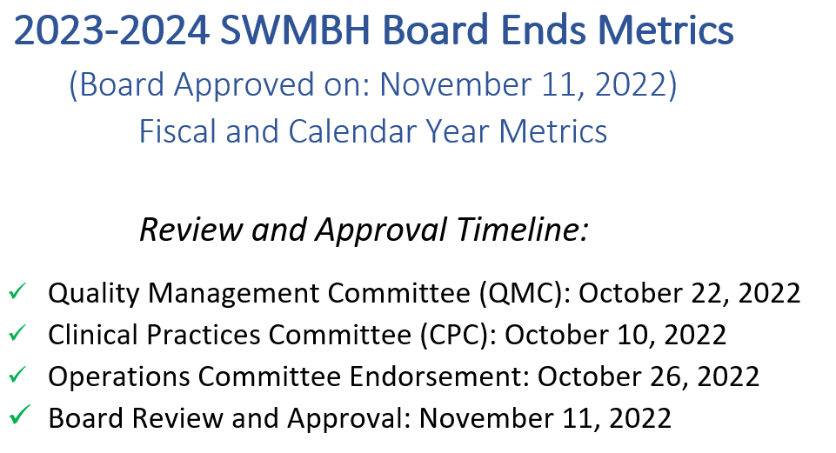
2023-2024 Board Ends Metrics

Slide 19
2023-2024 Board Ends Metrics
Metric Results Key: (Achieved) – (Pending) – (Not Met)
Metric | Description | Deliverable/Goal | Date Range & Current Status
Strategic Imperative Category: Quality of Life Persons with Intellectual Developmental Disabilities (I/DD); Serious Mental Illness (SMI); Serious Emotional Disturbances (SED); Autism Spectrum Disorders (ASD), and Substance Use Disorders (SUD) in the SWMBH region see improvements in their quality of life and maximize self- sufficiency, recovery and family preservation.
Metrics 1-5 are from the 2023 Performance Bonus Incentive Program
Achieve 95% of Veteran’s Metric Performance -Based Incentive Program monetary award based on FY23 MDHHS specifications. (25 pts. via MDHHS Contract) *1 point will be awarded for successful completion. Confirmation via MDHHS official PBIP report received in December 2023. SWMBH Metric Owner: Sarah Ameter and Natalie Spivak | This metric is in direct alignment with the 2023 Performance Bonus Incentive Program (PBIP) (P.1. PA 107 sec 105d) Identification of beneficiaries who may be eligible for services through the Veteran’s Administration. | Timely submission of Veteran Services Navigator collection form by the last day of the month following the end of each quarter. Submit BH TEDs data quality monitoring narrative report by 1/1/2023. Submit VSN – BH TEDs comparison narrative report by 7/1/2023. | Pending Reporting Period 10/1/23 – 9/30/23 Metric Board Report Date: October 13, 2023

Slide 20
2023-2024 Board Ends Metrics
Metric Results Key: (Achieved) – (Pending) – (Not Met)
Metric | Description | Deliverable/Goal | Date Range & Current Status
Achieve 95% of Increased Data Sharing Performance Bonus Incentive Program (PBIP) monetary award based on MDHHS specifications. *1 point will be awarded for successful completion. Confirmation via MDHHS official PBIP report received in December 2023. SWMBH Metric Owner: Natalie Spivak | This metric is in direct alignment with the 2023 Performance Bonus Incentive Program (PBIP) (P.2. PA 107 sec 105d) Sending ADT messages for purposes of care coordination through health information exchange. | SWMBH will submit to MDHHS a narrative report by 7/31/2023, listing CMHSP’s sending ADT messages, and barriers for those who are not, along with remediation efforts and plans. In the event that MiHIN cannot accept or process contractor’s ADT submissions this will not constitute failure on Contractor’s part. | Pending Reporting Period 10/1/23 – 9/30/23 Metric Board Report Date: October 13, 2023

Slide 21
2023-2024 Board Ends Metrics
Metric Results Key: (Achieved) – (Pending) – (Not Met)
SWMBH will achieve the FY23 Initiation and Engagement State Specified benchmarks and participate in DHHS led data validation activities. SWMBH Metric Owner: Joel Smith Supporting SL’s: Jonathan Gardner Alena Lacey | This metric is listed under section P.3. PA 107 sec 105d in the 2023 MDHHS PBIP specification table. This metric is also utilized for the 2023 PBIP, CCBHCC and OHH bonus incentive programs. The percentage of adolescents and adults with a new episode of alcohol or other drug (AOD) abuse or dependence who received the following: 1. Initiation of AOD Treatment: The percentage of beneficiaries who initiate treatment within 14 calendar days of the diagnosis. 2. Engagement of AOD Treatment: The percentage of beneficiaries who initiated treatment and who had two or more additional AOD services or Medication Assisted Treatment (MAT) within 34 calendar days of the initiation visit. | The PIHP must participate in DHHS planned and DHHS-provided data validation activities and meetings. PIHPs will be provided IET data files by January 31 each year, and within 120 calendar days, return their data validation template, completed, to DHHS. 1 point CCBHC Goal – Participating CCBHC sites achieve IET- 14-day metric at 42.5% and the IET-34-day metric at 18.5% per state indicated benchmarks. ½ point each | Pending Data Collection Period 10/1/22 – 9/30/23 Metric Board Report Date: November 10, 2023

Slide 22
2023-2024 Board Ends Metrics
Metric Results Key: (Achieved) – (Pending) – (Not Met)
Metric | Description | Deliverable/Goal | Date Range & Current Status
SWMBH will submit a qualitative narrative report to MDHHS receiving no less than 90% of possible points; by November 15, 2023, summarizing prior FY efforts, activities, and achievement of the PIHP and CMHSPs, specific to Patient-Centered Care activities and programs throughout the PIHP region. *1 point will be awarded for successful completion. Confirmation via MDHHS official PBIP report received in December 2023. SWMBH Metric Owner: Jonathan Gardner Supporting SL’s: Alena Lacey | This metric is in direct alignment with the 2023 Performance Bonus Incentive Program (PBIP) (P.4. PA 107 sec 105d) Points for Narrative Reports will be awarded on a pass/fail basis, with full credit awarded for submitted narrative reports, without regard to the substantive information provided. The State will provide consultation draft review response to the Contractor by January 15th. The Contractor will have until January 31st to reply to the State with information. | The Contractor must submit a narrative report of no more than 10 pages by November 15, 2023 summarizing prior FY efforts, activities, and achievements of the Contractor (and component CMHSPs if applicable) to increase participation in patient-centered medical homes. The specific information to be addressed in the narrative is below: 1. Comprehensive Care 2. Patient-Centered 3. Coordinated Care 4. Accessible Services 5. Quality & Safety | Pending Reporting Period 10/1/23 – 9/30/23 Metric Board Report Date: February 9, 2024

Slide 23
2023-2024 Board Ends Metrics
Metric Results Key: (Achieved) – (Pending) – (Not Met)
Metric | Description | Deliverable/Goal | Date Range & Current Status
Achieve Compliance (based on MDHHS specified benchmarks) on Follow-up After Hospitalization for Mental Illness within 30 days (FUH) for beneficiaries six year of age and older and show a reduction in disparity with one minority group. SWMBH Metric Owner: Alena Lacey | This metric is in direct alignment with the 2023 Performance Bonus Incentive Program (PBIP) (J.2. PA 107 sec 105d) The points will be awarded based on MHP/Contractor combination performance measure rates. The total potential points will be the same regardless of the number of MHP/Contractor combinations for a given entity. | Plans will meet set standard for follow-up within 30 days for each rate (ages 6-17) and (18 and older). Plans will be measured against the adult minimum standard of 58% and child minimum standard of 70%. The measurement period will be calendar year 2022. Data will be stratified by race/ethnicity by MDHHS and delivered to PIHP's. PIHP's will be incentivized to reduce a disparity between the index population and at least one minority group. The measurement will be a comparison of calendar year 2021 with calendar year 2022. | Pending Data Collection Period 1/1/23 – 12/31/23 Metric Board Report Date: February 9, 2024

Slide 24
2023-2024 Board Ends Metrics
Metric Results Key: (Achieved) – (Pending) – (Not Met)
Strategic Imperative Category: Exceptional/Access to Care Persons and families served are highly satisfied with the services they receive.
2023 Customer Satisfaction Surveys collected by SWMBH are at or above the 2022 results identified in (a & b) and performance improvement areas/plans are identified. SWMBH Metric Owner: Jonathan Gardner Supporting SL’s: Sarah Ameter, Anne Wickham and Mila Todd | This metric is in direct alignment with Section V of the 2023 MDHHS-PIHP contract ‘Member Experience with Services’ The survey methodology must include a quantitative assessment (e.g., surveys) of member experience with services. The methodology must include a qualitative assessment (e.g., focus groups) of member experience with services. | Mental Health Statistic Improvement Project Survey (MHSIP) tool. (Improved Functioning – baseline: 84.1%) point. b. Youth Satisfaction Survey (YSS) tools. (Improved Outcomes – baseline 81.3%) point. Complete a series of Consumer oriented focus groups and work with the Consumer Advisory Committee to document, understand and act upon potential improvement efforts that impact overall Consumer Satisfaction. point. Ensure that each CMHSP partner reviews site specific survey results and formulates Corrective Action Plans to drive identified or potential improvement areas. | Pending Survey Collection Period 10/1/23 – 12/30/23 Metric Board Report Date: February 9, 2024

Slide 25
2023-2024 Board Ends Metrics
Metric Results Key: (Achieved) – (Pending) – (Not Met)
Metric | Description | Deliverable/Goal | Date Range & Current Status
Michigan Mission Based Performance Indicator System (MMBPIS) Data, Tracking and Analysis SWMBH Metric Owner: Jonathan Gardner Supporting SL: Joel Smith Alena Lacey | As directed by the 2023 MDHHS-PIHP contract Section I ‘Performance Indicators’. The PIHP must include performance measures established by MDHHS in the areas of access, efficiency and outcomes. The PIHP must track and perform analysis to ensure each performance indicator is meeting the minimum performance benchmark/standard. Currently (7) Indicators have targeted benchmarks. | 24/28 indicators meet the State Benchmark, throughout all FY23 for 4 consecutive quarters 1 point. Indicator 3a,b,c & d achieve a 3% combined improvement (through FY 23 all 4 Quarters) over 2022 baseline (1/2 pt. each) 2 points. | Pending Data Collection Period 10/1/22 – 9/30/23 MMBPIS Performance Indicator Descriptions Metric Board Report Date: February 9, 2024

Slide 26
2023-2024 Board Ends Metrics
Metric Results Key: (Achieved) – (Pending) – (Not Met)
2023 CCBHC Program Customer Satisfaction Surveys collected by SWMBH represent an 85% First Year “in agreement” Satisfaction rate average across all categories measured. SWMBH Metric Owner: Jonathan Gardner and Ella Philander | Per the 2022 CCBHC codebook section 13.B.2 and 13.B.3; the PIHP is responsible for evaluation and overall member satisfaction of the CCBHC program. The survey and assessment should consider availability and accessibility to services for eligible consumers, not just those being served. Focus groups, satisfaction surveys or advisory councils should be reviewed to determine appropriateness of service site locations. | SWMBH will administer an annual CCBHC consumer satisfaction survey, collecting responses from CCBHC participants using a hybrid MHSIP and YSS survey tool approved by MDHHS. ½ point SWMBH will complete analysis and reports for MDHHS and CCBHC locations, delivering results and identified areas/opportunities for improvement by June 2023. ½ point | Pending Data Collection Period 10/1/22 – 3/30/23 Metric Board Report Date: July 14, 2023

Slide 27
2023-2024 Board Ends Metrics
Metric Results Key: (Achieved) – (Pending) – (Not Met)
Strategic Imperative Category: Quality and Efficiency The SWMBH region is a learning region where quality and cost are measured, improved, and reported.
Metric | Description | Deliverable/Goal | Date Range & Current Status
2023 Health Service Advisory Group (HSAG) External Quality Compliance Review (EQR) Results and Improvement Strategies SWMBH Metric Owner: All SL’s with contributor’s dependent on Standards selected for review during specified Fiscal Year | As directed by the 2023 MDHHS PIHP contract Attachment P 7.7.1.1 – Amendment 1 – Medicaid Managed Specialty Supports Services/Programs, the PIHP must adhere to annual audits of the following categories: Member Rights, Emergency Services, Availability of Services, Assurances and Capacity of Services, Coordination of Care, Provider Selection, Confidentiality, Grievance and Appeals System, Sub contractual Delegation, Practice Guidelines, Health Information Systems and Quality Assessment and Performance Improvement Programs. | All standards or corrective action plans reviewed, will receive a score of 90% compliance, or designation that the standard has been “Met” or “Accepted” or SWMBH will be within the top 2 scoring Michigan PIHP’s. 1 Point. | Pending Data Collection Period 10/1/22 – 9/30/23 Metric Board Report Date: November 10, 2023

Slide 28
2023-2024 Board Ends Metrics
Metric Results Key: (Achieved) – (Pending) – (Not Met)
2023 HSAG Performance Measure Validation (PMV) Audit Results and Improvement Strategies SWMBH Metric Owner: Natalie Spivak SL Contributors: Jonathan Gardner and other contributor’s dependent on Standards selected for review during specified Fiscal Year | As directed by the 2023 MDHHS PIHP contract Attachment P 7.7.1.1 – Amendment 1 – Medicaid Managed Specialty Supports Services/Programs, the PIHP must adhere to annual audits of the following categories: Data Integration, Data Control, Data Accuracy and Performance Indicator Validation. | All standards or corrective action plans reviewed, will receive a score of 90% compliance, or designation that the standard has been “Met” or “Accepted” or SWMBH will be within the top 2 scoring Michigan PIHP’s 1 Point. | Pending Data Collection Period 1/1/23 – 6/30/23 Metric Board Report Date: November 10, 2023

Slide 29
2023-2024 Board Ends Metrics
Metric Results Key: (Achieved) – (Pending) – (Not Met)
Strategic Imperative Category: Improved Health Individual mental health, physical health and functionality are measured and improved
Metric | Description | Deliverable/Goal | Date Range & Current Status
SWMBH will achieve CCBHC Demonstration Year 1 Quality Bonus Payment Metrics (QBP’s), against the States FY23 indicated Benchmarks. SWMBH Metric Owner: Ella and Jonathan CMHSP Contributions/Owners: ISK and St. Joe | As directed by the 2023 CCBHC Handbook under Table 1.A.1 – QBP Metrics and Benchmarks. The Regional PIHP will work with CMSHP-CCBHC participant programs to define processes and strategies for collection and reporting data. The PIHP will be the primary liaison for the submission of all required reports and follow-ups as directed by MDHHS. SWMBH will submit reports based on the identified metrics to MDHHS within 6 months of DY 1 or by 3/31/2023. | Child and Adolescent Major Depressive Disorder; Suicide Risk Assessment (SRA-BHC - 23.9%) Major Depressive Disorder, Suicide Risk Assessment (SRA-A - 12.5%) Adherence to Antipsychotic Meds for Individuals with Schizophrenia (SAA-AD – 58.5%) Follow-up after Hosp. for mental illness, ages 18+ (FUH-AD – 58%) Follow-up after Hospitalization for Children (FUH-CH – 70%) initiation and Engagement of Alcohol and other drugs (IET-14 – 42.5% & IET-34- 18.5%) | Pending *.5 bonus point for each metric (1-6) successfully achieved. Data Collection Period 10/1/22 – 3/30/24 Metric Board Report Date: November 10, 2023

Slide 30
2023-2024 Board Ends Metrics
Metric Results Key: (Achieved) – (Pending) – (Not Met)
SWMBH will retain 60% of (OHH) enrollees, enrolled after 9/30/22. Program Enrollees must maintain ‘enrolled’ status for at least 6 months. SWMBH Metric Owner: Joel Smith | The retention metric is defined within the OHH handbook for Performance Year 2 goals (10/1/22 through 9/30/23). Further guidance on the metric can be found by clicking on the resource below. www.michigan.gov/OHH. | 334 Enrollees in the OHH Program as of 9/30/22 OHH retention Metric: 60% of enrollees enrolled after 9/30/22 will remain in “enrolled” status for at least 6 months. (200 enrolled members by March 31, 2023) 1 point | Pending Data Collection Period 10/1/22 – 3/31/23 Metric Board Report Date: May 12, 2023
SWMBH will meet or exceed the Behavioral Health Treatment Episode Data Set (BH TEDS) compliance benchmarks established by MDHHS for FY23. SWMBH Metric Owner: Natalie Spivak | As directed by the 2023 MDHHS-SWMBH contract, performance metrics table, SWMBH shall maintain a 95% compliance rate within the applicable Mental Health, Substance Use Disorder and Crisis BH TEDs fields. Each element (MH, SUD and Crisis) must have a matching and accepted BH TEDs record, as confirmed by the MDHHS quarterly status report. | 97% of applicable MH served clients (with an accepted encounter) will have a matching and accepted BH TEDS record, as confirmed by the MDHHS quarterly status report. 1 point 97% of applicable SUD served clients (with an accepted encounter) will have a matching and accepted BH TEDS record, as confirmed by the MDHHS quarterly status report. 1 point 97% of applicable Crisis served clients (with accepted encounter) will have a matching BH TEDS record, as confirmed by MDHHS quarterly status report. 1 point | Pending Data Collection Period 1/1/23 – 12/31/23 Metric Board Report Date: January 12, 2024

Slide 31
2023-2024 Board Ends Metrics
Metric Results Key: (Achieved) – (Pending) – (Not Met)
Strategic Imperative Category: Mission and Value Driven CMHSPs and SWMBH fulfill their agencies' missions and support the values of the public mental health system.
Metric | Description | Deliverable/Goal | Date Range & Current Status
SWMBH will meet or exceed FY23 contractual Critical Incident Reporting timeliness and efficiency benchmarks utilizing the new DHHS Customer Management System (CRM) SWMBH Metric Owner: Jonathan Gardner SL Contributors: Alena Lacey and SWMBH Chiefs | As of 10/1/2022, DHHS is requiring PIHP’s to report through its new CRM system. The PIHP must meet the timeliness reporting standards to DHHS of: Immediate Events – 48 hours after becoming aware of the incident, Sentinel Events and Critical Incidents – 30 days after the end of the month in which the event occurred. The new CRM system requires that the PIHP provides timely updates as requested/assigned by DHHS. | SWMBH will submit all required incidents, meeting the identified benchmarks for Immediate, Sentinel and Critical Events. Final status will be provided through DHHS annual review results. 1 point SWMBH will provide annual CI site review audits on CMHSP’s to ensure; timely reporting of Critical Incidents, appropriate documentation, involving the appropriate personnel, and using the information to address quality of care at their sites. ½ point SWMBH will convene the internal Immediate/Sentinel Event review task force, as needed; to ensure root cause analysis and other required elements were in compliance with contractual policy standards. | Pending Data Collection Period 10/1/22 – 9/30/23 Metric Board Report Date: November 10, 2023

Slide 32
2023-2024 Board Ends Metrics
Metric Results Key: (Achieved) – (Pending) – (Not Met)
SWMBH will meet or exceed MDHHS FY23 Autism Benefit Waiver Access to Care and Timeliness Standards SWMBH Metric Owner: Alena Lacey | SWMBH and MDHHS have placed emphasis on the underserved Autism population during 2023 and providing increased access and timeliness of services for those who have been waiting longer than 90 days for IPOS development and over 48 hours from referral to first scheduled appointment. The following metrics are State sponsored and targeted towards improving access and timeliness of service for consumers with an autism diagnosis. | Targeting Underserved Population: 30% improvement completing IPOS for consumers with Autism diagnosis who do not currently have an active IPOS in managed care system, or valid reason for inactivity listed in their record . (baseline 125 – 37 completed IPOS by 9.30.23). ½ point Decrease rate of overdue (over 90 days) autism ‘re-evaluations’ within the SWMBH region by 10% by (9.30.23). Current rate of overdue evaluations is 20% (86/859)=10%. ½ point | Pending Data Collection Period 10/1/22 – 9/30/23 Metric Board Report Date: November 10, 2023

Slide 33
Evaluation of Performance 2022 Performance Metrics
Successful management of the HSAG Compliance Audit, Performance Improvement Projects (PIPs), Michigan Department of Health and Human Services and Performance Measure Validation Audits.
Successful management and completion of MI Health Link audits and reviews.
Successful submission of data elements: Jail Diversion, Behavioral Treatment Review Committee (BTRC) Minutes, MMBPIS, and Critical Incidents to MDHHS.
Successful completion of all established targets identified in: 2020 Board Ends Metrics.
Successful completion of all QAPI and UM Department goals.
Successful completion of MI Health Link contract reporting requirements with Integrated Care Organizations (ICOs).
Successful in capturing MHL Quality Withhold Bonus Awards for good performance.
Successful completion of all established Quality Management Committee goals.
Continued improvement in Consumer Satisfaction Survey scores.
Successful completion of identified budget savings initiatives.
Successful completion of Legislative Events and agendas.
Ranked 1st amongst all Michigan PIHP's in the 2021 Health Service Advisory Group (HSAG) External Quality Compliance Results.

Slide 34
Oversight and Monitoring

Slide 35
SWMBH Audit & Monitoring
Program Integrity & Compliance
Medicaid Services Verification Audit
  Quarterly review of services paid for by Medicaid, provided by CMHSPs, subcontractors, SUD providers, top 3 external providers, and top 3 hospitals
Medicare Claims Audit (Duals)
  Monthly review of a minimum of 100 MHL claims
Inpatient Audit
  Annual review of 100 inpatient psychiatric stays paid for by Medicaid
  Includes a code audit of 50 physician codes
HCBS provided in the consumer’s home
  Annual review based on past and continued OIG focus
FY20 implementation
  Block Grant Fee-For-Service claims review
  Oversight of Block Grant Financial Status Reports and SA Data Templates for Net Cost Contracts
Annual Audit & Monitoring Plan and Calendar are vetted through the Regional Compliance Coordinating Committee

Slide 36
SWMBH Audit & Monitoring
Provider Network
Administrative Site Reviews
  Region-wide review of all CMH subcontractors and SUD providers
  Coordinated between SWMBH and CMHSPs
SUD Clinical Quality Review
  Annual review of 5% or minimum 8 records for each SUD provider
CMHSP Clinical Quality Review
  Annual review of minimum of 30 consumer records
  Focuses on entire scope of care
  Samples stratified to pre-determined focus areas (ex. Autism)
Delegated Functions Reviews
  Annual review of Medicaid functions delegated to CMHSPs
  Combination desk audit and on-site review
  Required by PIHP contract with DHHS, SWMBH-CMHSP Delegation Agreements, and Federal Medicaid Managed Care Rules – 42 CFR 438
  Assesses the CMHSPs’ business practices around Delegated Managed Care Functions in the areas of:
    Utilization Management, Customer Services, Grievance and Appeals, Quality Management/Information Technology, Claims Management, and Provider Network.
  Failure to meet PIHP, DHHS, and/or federal requirements could eventually result in revocation of a delegated function.

Slide 37
SWMBH Audit & Monitoring
SUD & Prevention
Prevention Reviews
  Annual review of each Prevention contractor to monitor if contractual outcomes are met
  Monitors prevention activities entered in to State database
P.A. 2 Work Plans and Block Grant Net-Cost Contracts
  Contractually prescribed goals and outcomes
  P.A. 2 providers report outcomes measures twice per year

Slide 38
Population Health and Integrated Care

Slide 39
What is Population Health?
Population Health
Population health is defined as the health outcomes of a group of individuals, including the distribution of such outcomes within the group. It represents a change from individual-level focus of most mainstream medicine, and seeks to complement traditional efforts of public health agencies by addressing a broader range of factors shown to impact the health of different populations.
From a population health perspective, health has been defined not simply as a state free from disease but as "the capacity of people to adapt to, respond to, or control life's challenges and changes." The World Health Organization (WHO) defined health in its broader sense in 1946 as "a state of complete physical, mental, and social well-being and not merely the absence of disease or infirmity.”

Slide 40
population health management – comprehensive approach
The graphic below identifies the spectrum of population, from the healthy to catastrophic with recommended initiatives for each sub-population with particular emphasis on the 15% of members driving 85% of costs.
( 37)

Slide 41
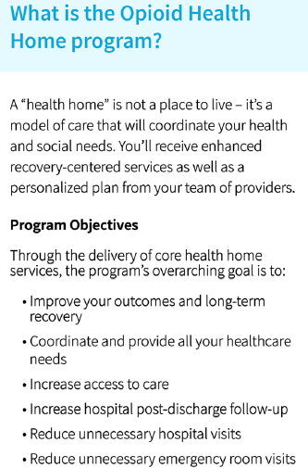
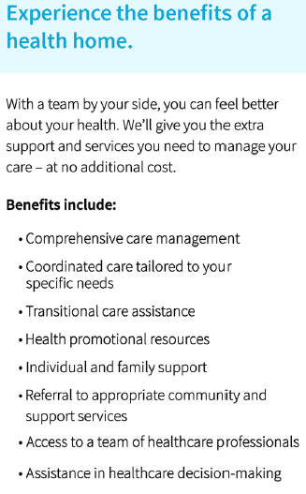
Opioid Health Home Program

Slide 42
